Slide 1


Food Classification
Using Transfer Learning

Slide 2
Table of contents
01
02
Problem Statment
Data Acquisition
03
04
Data Preparation
Models Training/Testing

Slide 3
Introduction
In this project, we address the food classification problem using transfer learning. By leveraging pre-trained deep learning models like AlexNet, VGG19, ResNet, and Inception, we aim to accurately classify food images into three categories: pizza, burger, and ice cream. Our focus is on achieving high performance while avoiding overfitting through the utilization of transfer learning techniques.

Slide 4
Problem Statement
01
Create a food classification system using transfer learning to accurately categorize pizza, burger, and ice cream images, while mitigating overfitting and ensuring reliable classification performance for dietary analysis and food recommendation applications.

Slide 5
02
Data Acquisition

Slide 6

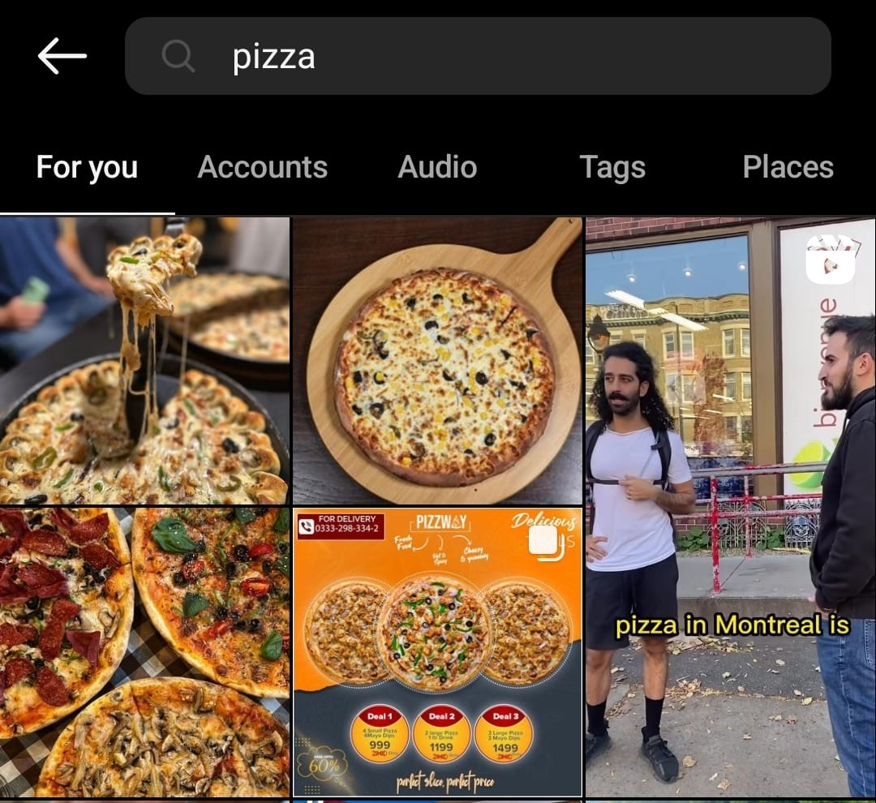
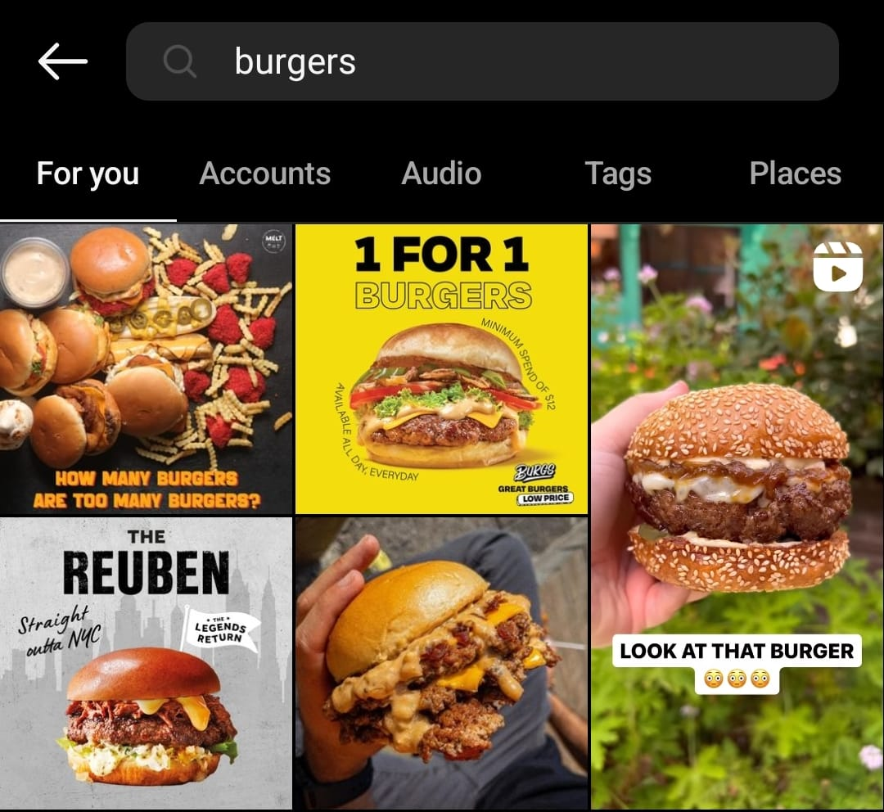
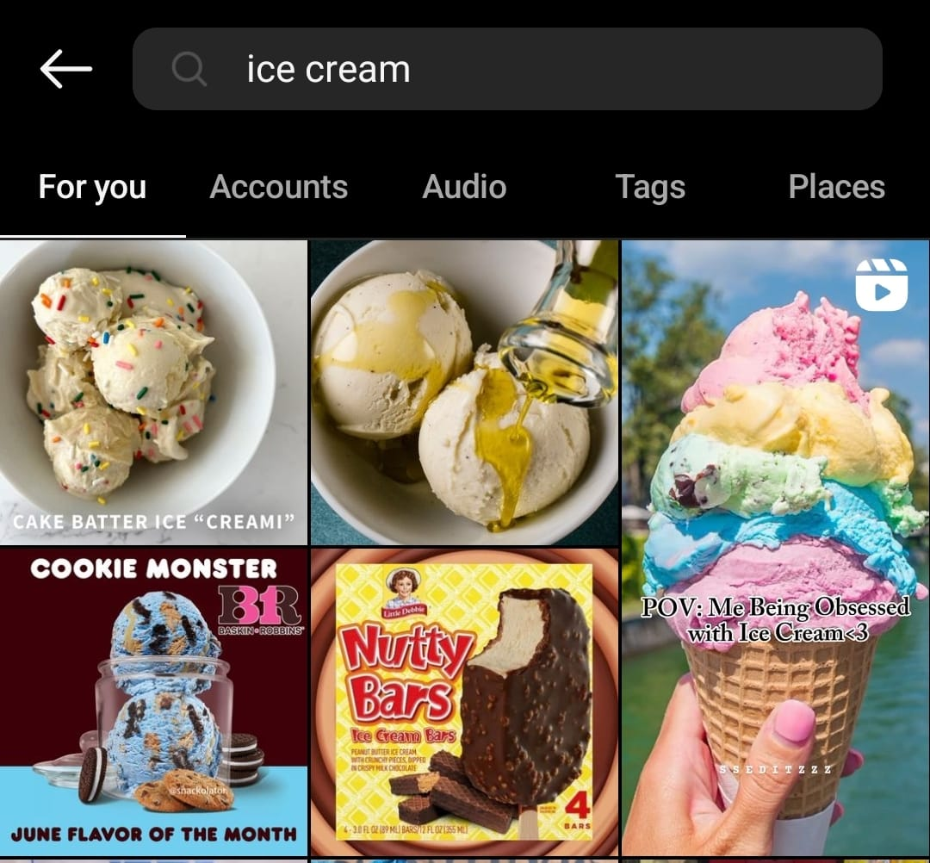
Instagram
The dataset for food classification was obtained from Instagram, comprising images of pizza, burger, and ice cream, enabling the development of a food classification system using transfer learning.

Slide 7
03
Data Preparation

Slide 8
Image Collection
Images of pizza, burger, and ice cream were collected from Instagram using relevant hashtags and location-based searches, resulting in a diverse dataset representing different variations of the food categories.

Slide 9

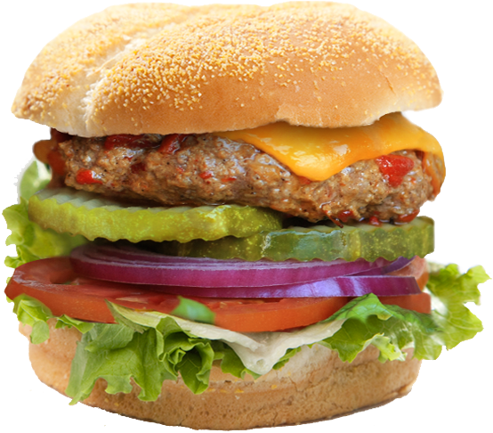
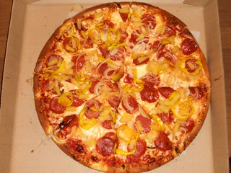
Data Cleaning
Data Cleaning: The collected images were manually reviewed and irrelevant or low-quality images were removed. Any watermarks, logos, or text overlays were also eliminated to ensure the focus is solely on the food items.

Slide 10
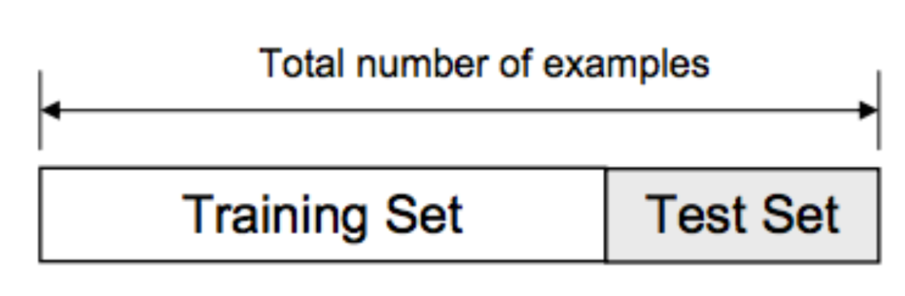
Train Test Split
Train-Test Split: The dataset was randomly divided into training and testing sets, ensuring an appropriate ratio to evaluate the model's performance accurately. The split maintains the class distribution in both sets, preventing class imbalance issues.

Slide 11
04
Models Training Testing

Slide 12
Model Training Testing
VGG19
V
R
I
D
Resnet
Inception
DenseNet
M
E
MobileNet
EfficientNet

Slide 13
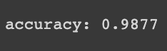
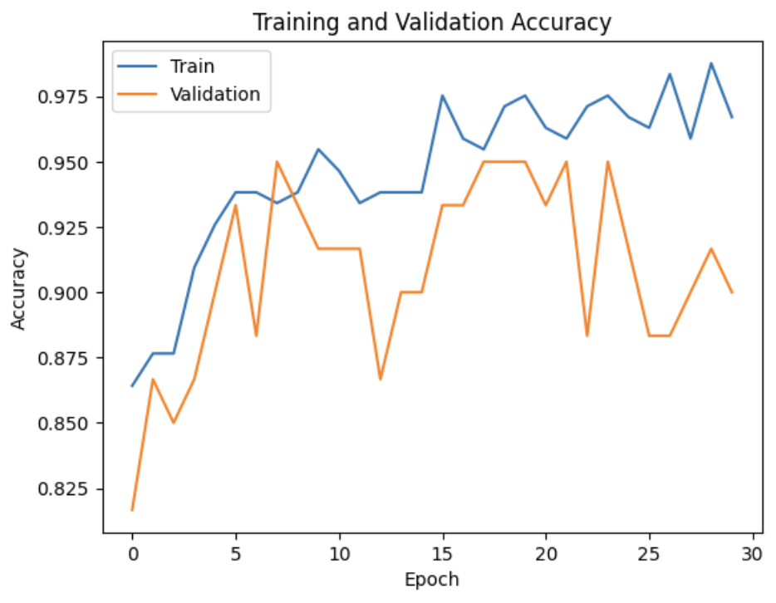
VGG19

Slide 14
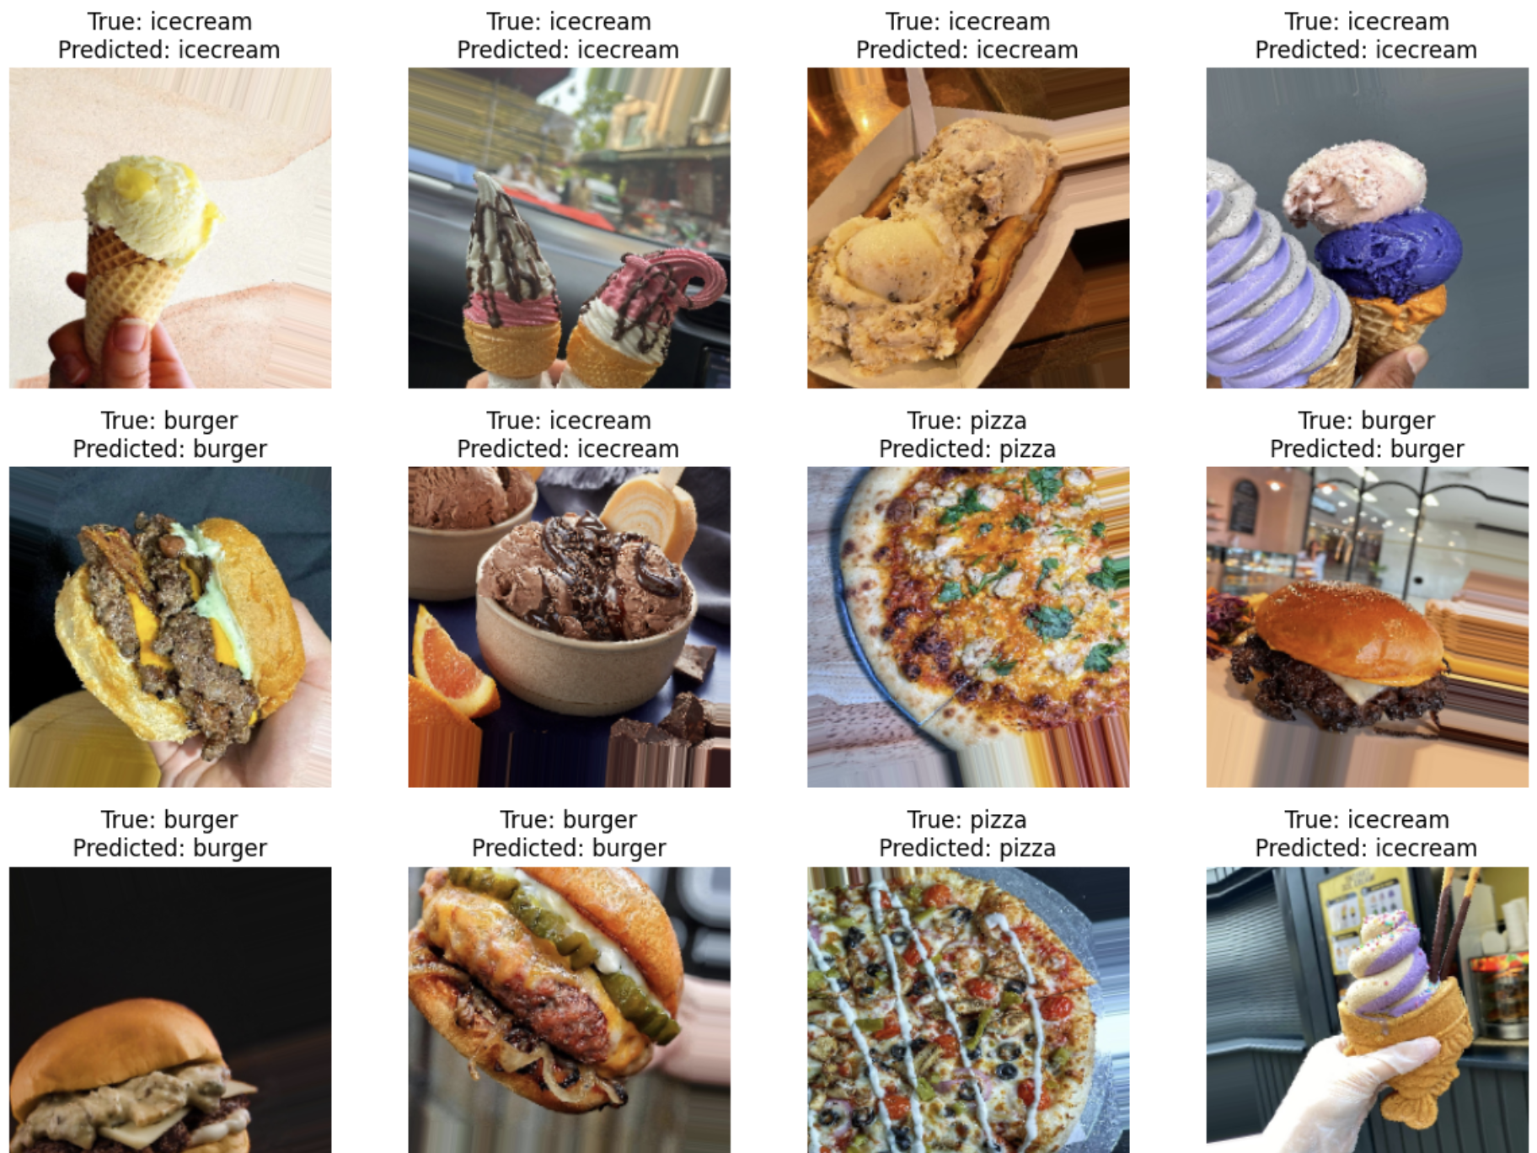
VGG19

Slide 15

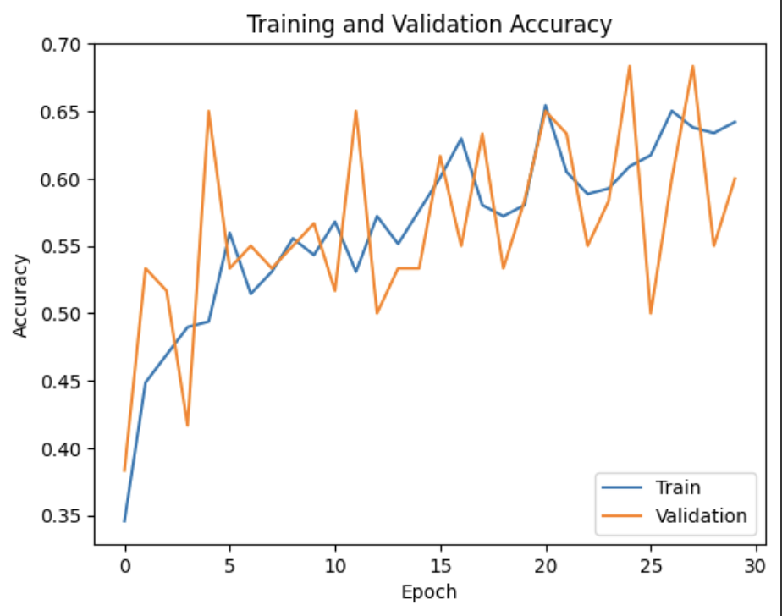
Resnet50

Slide 16
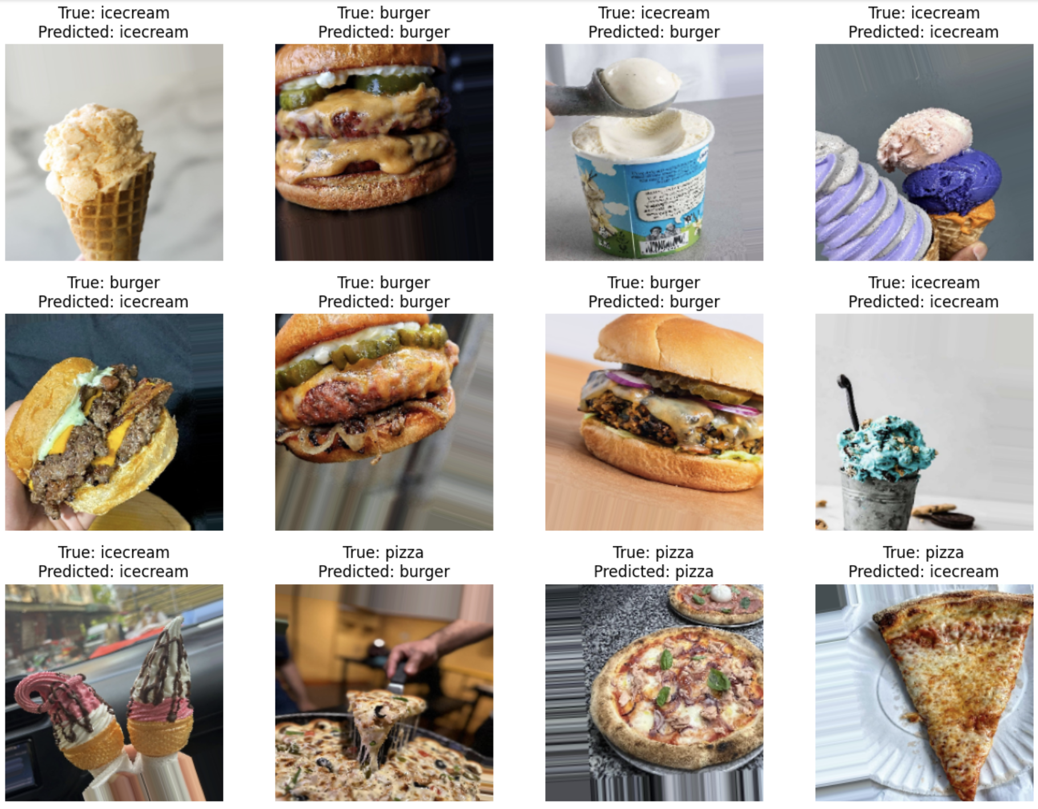
Resnet50

Slide 17

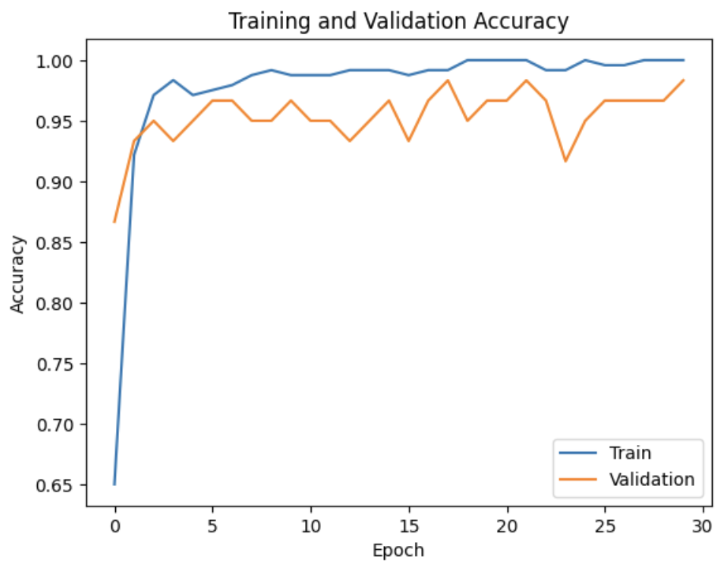
InceptionV3

Slide 18
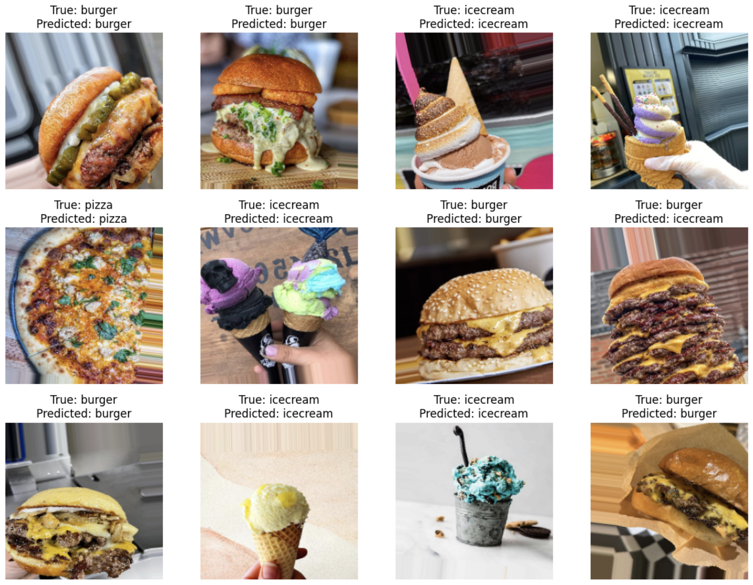
InceptionV3

Slide 19

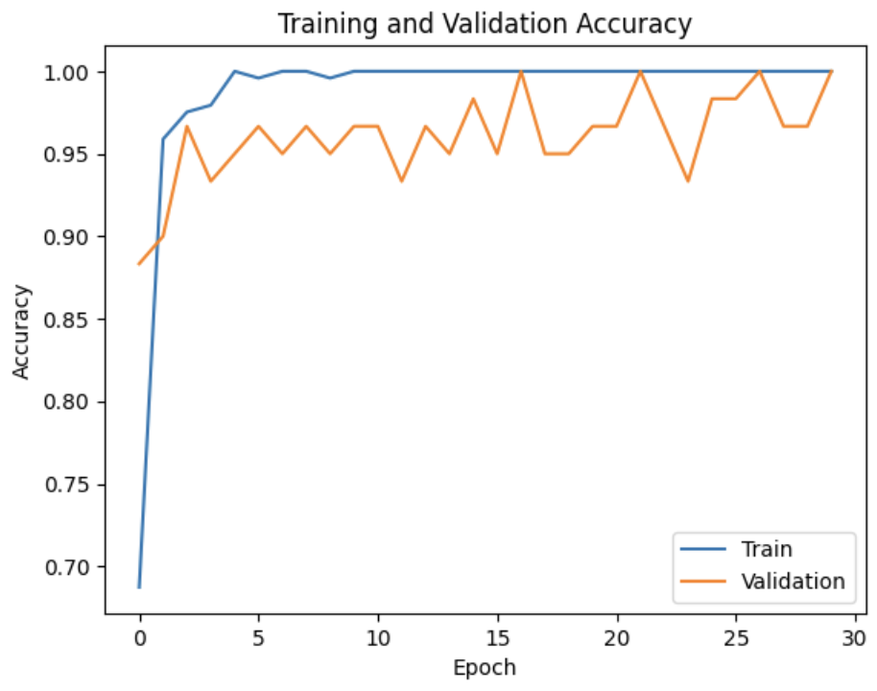
DenseNet121

Slide 20
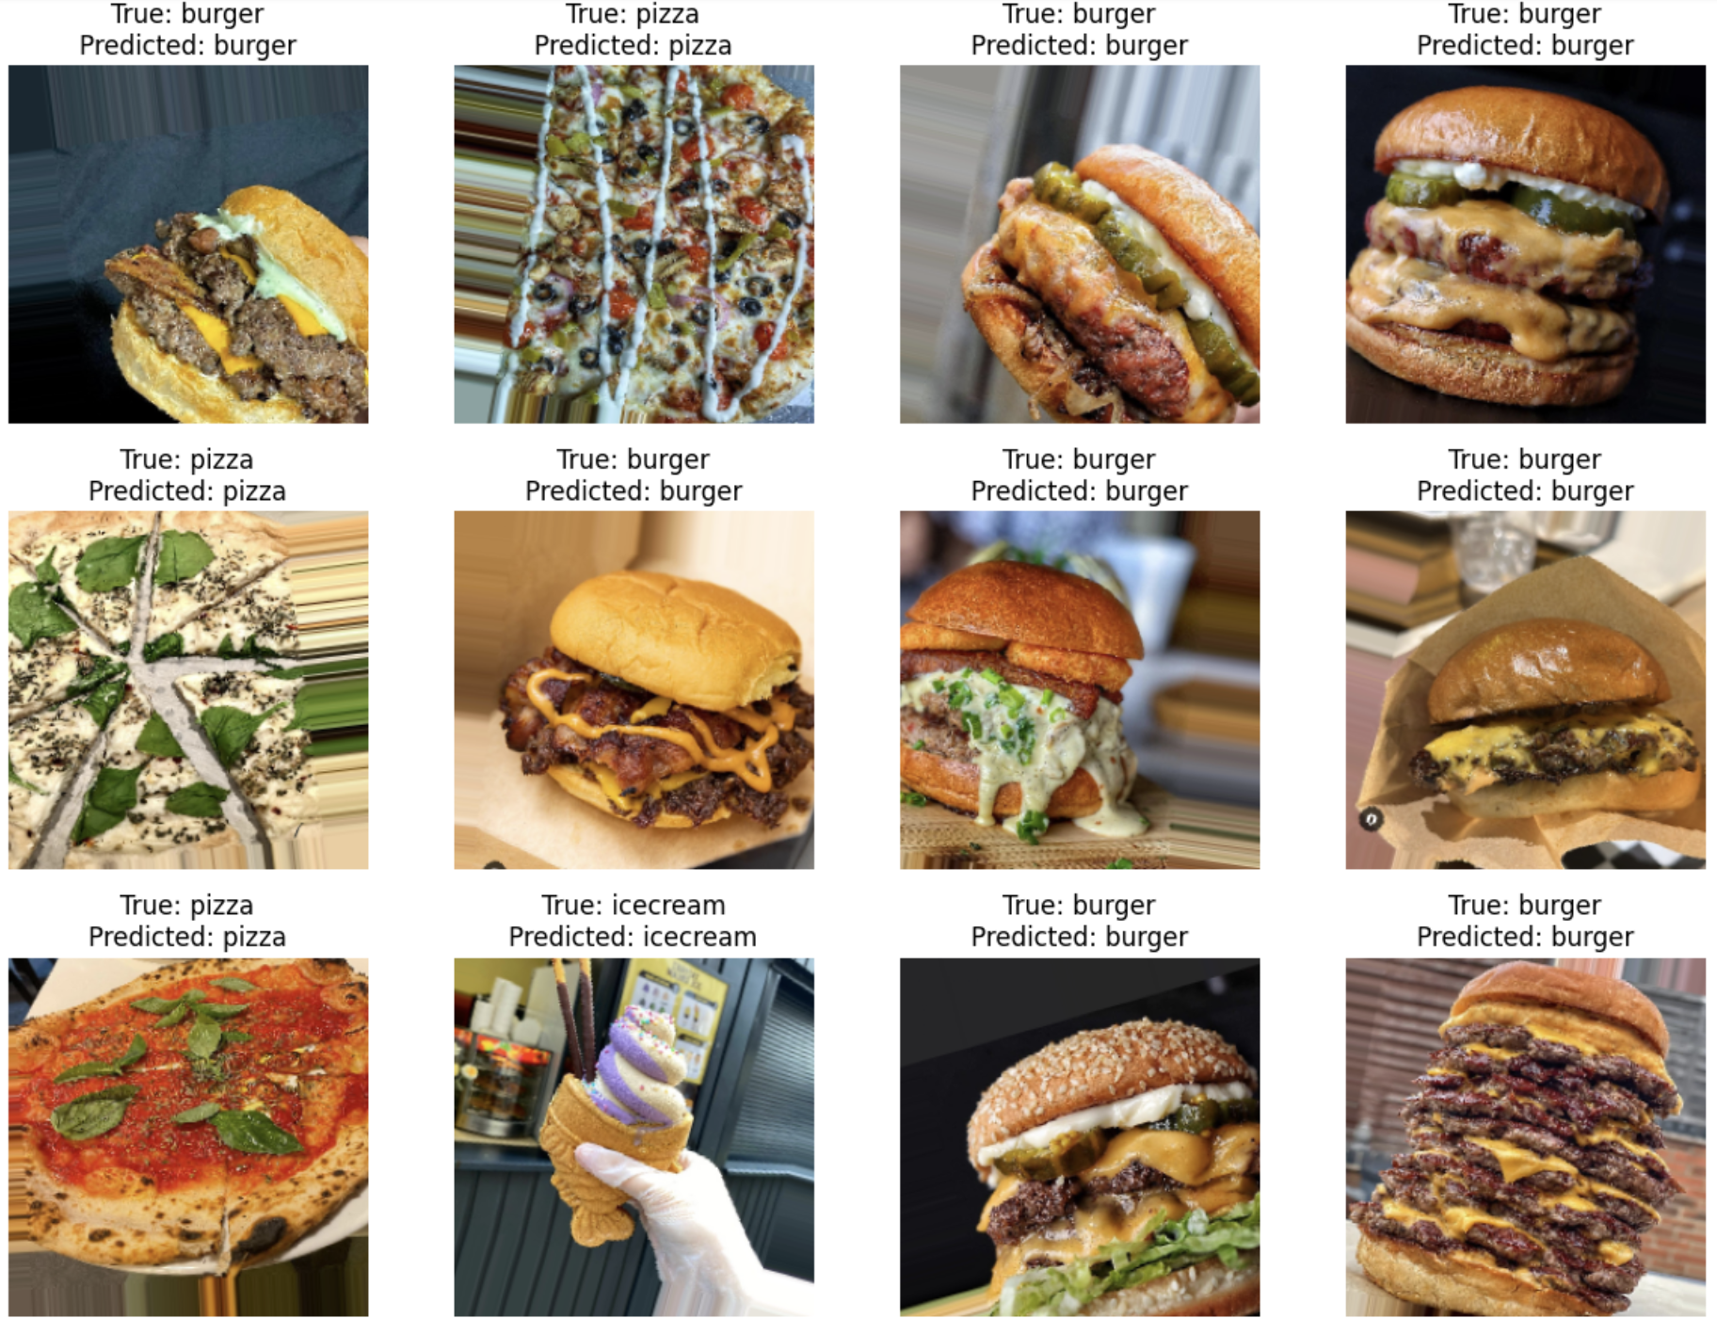
DenseNet121

Slide 21
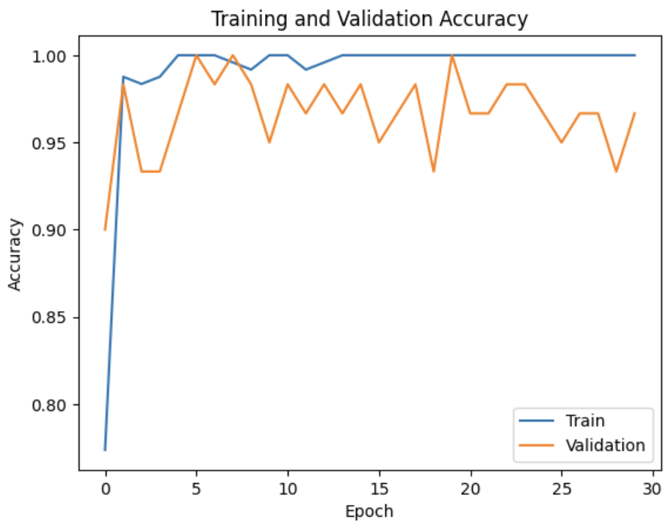
MobileNetV2

Slide 22
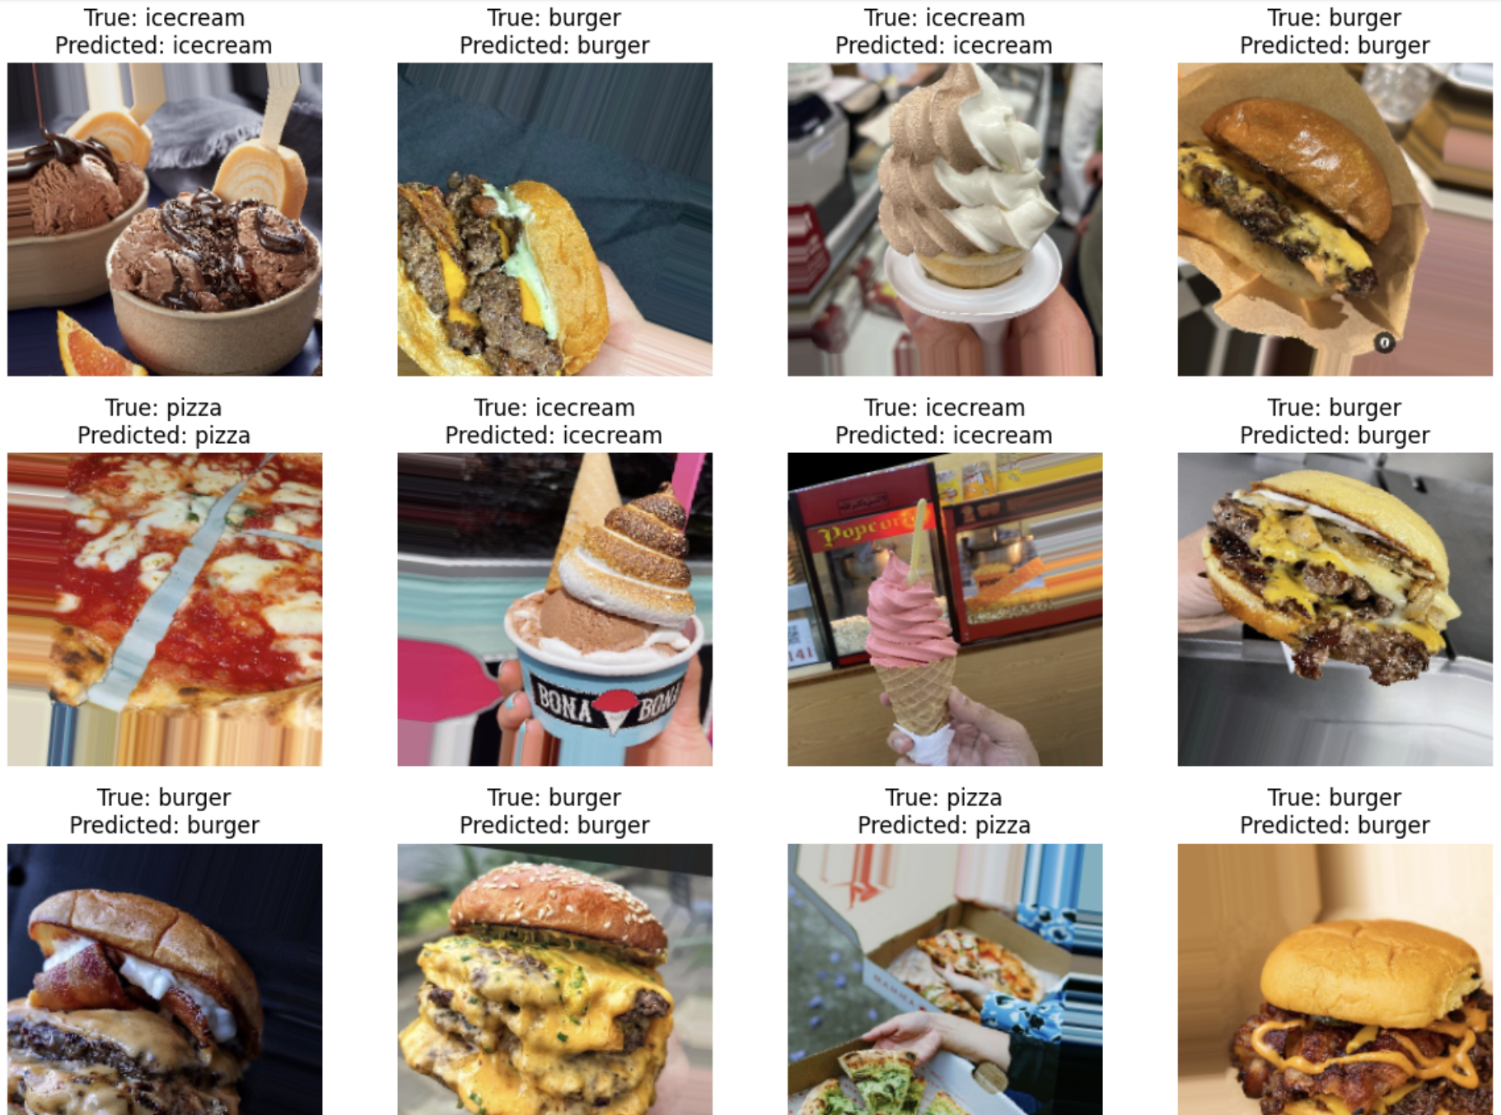
MobileNetV2

Slide 23
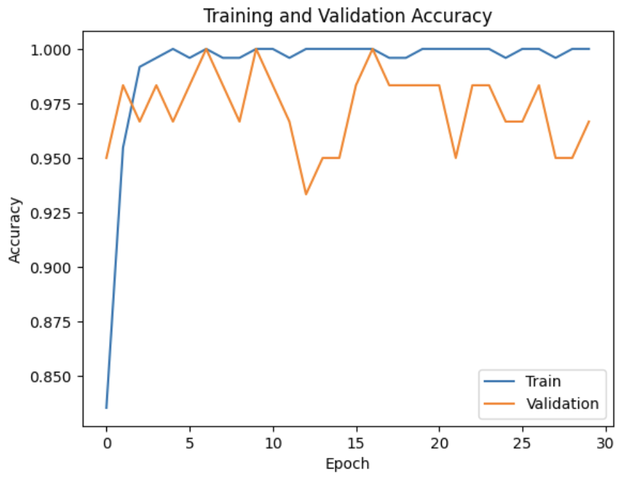
EfficientNet

Slide 24
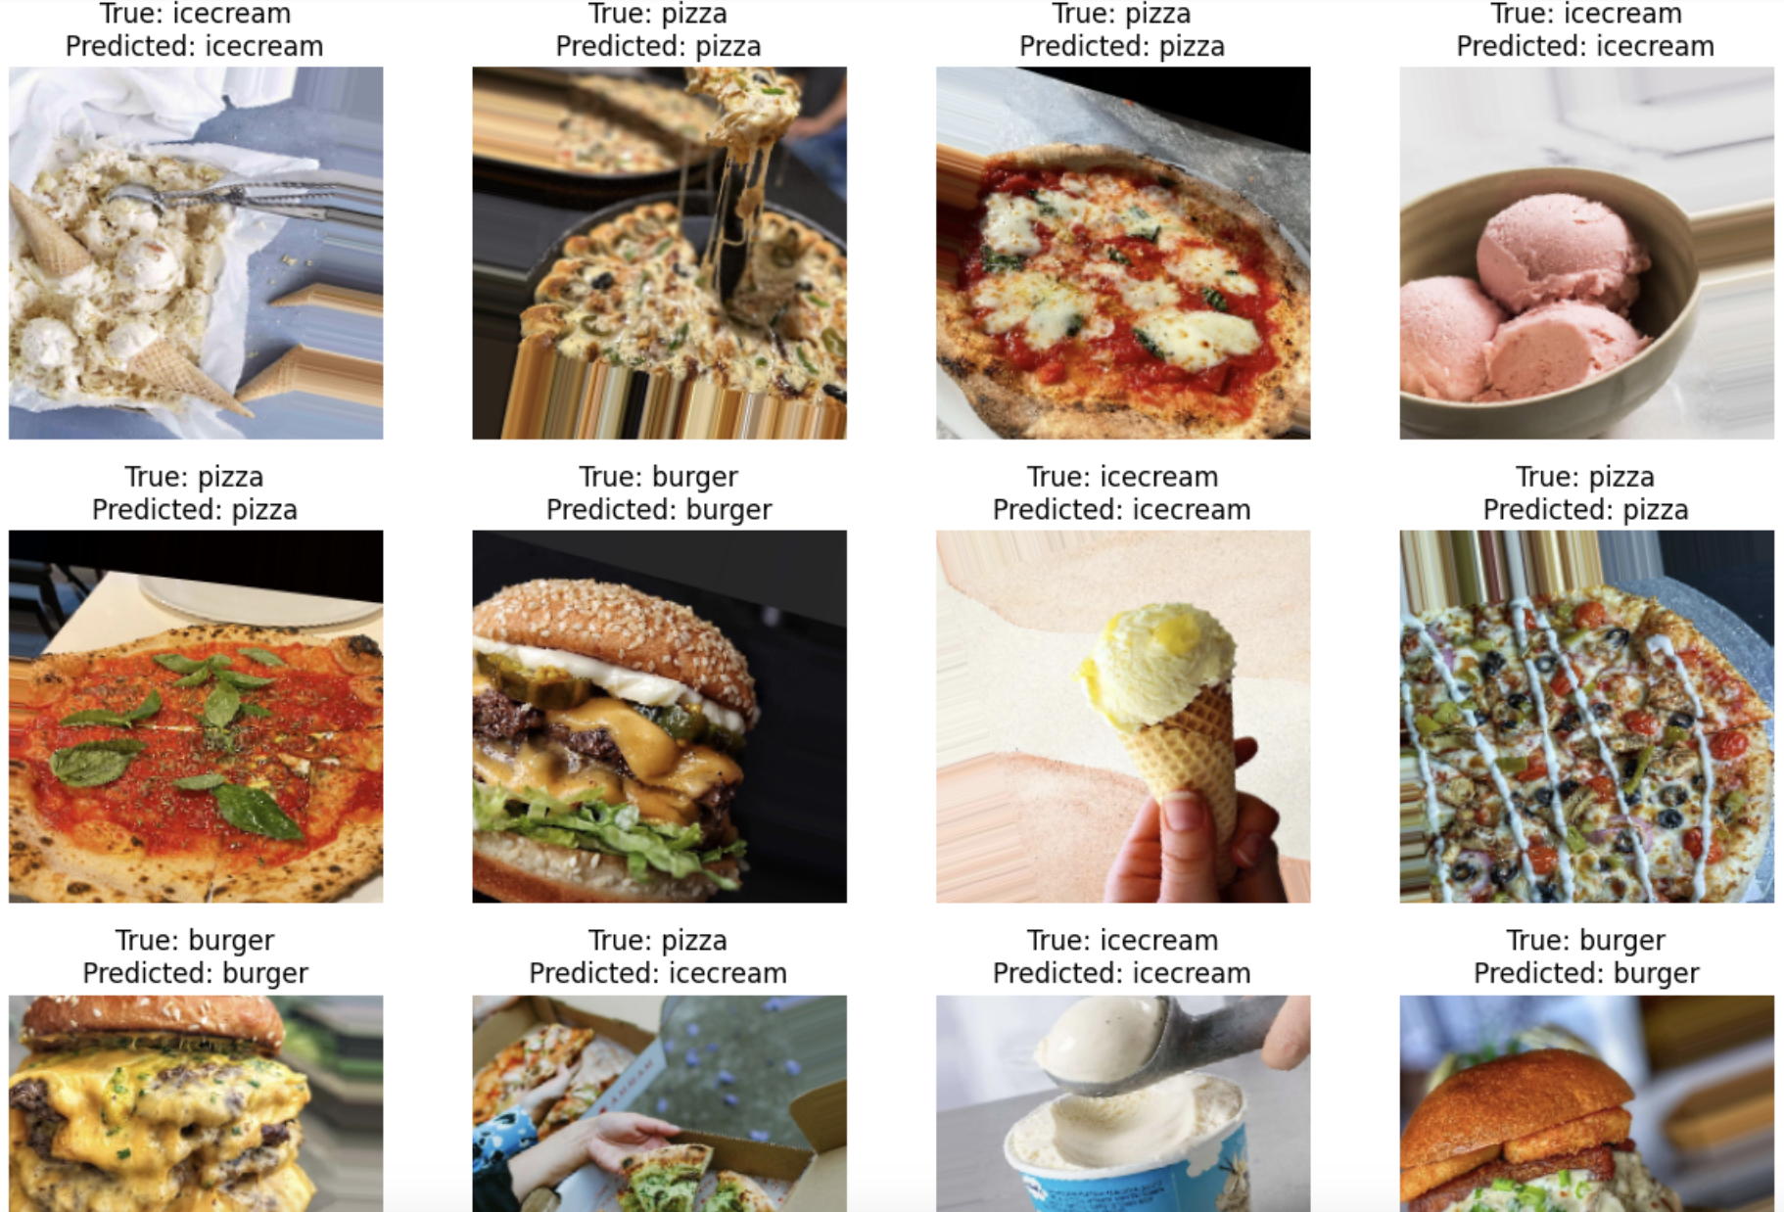
EfficientNet

Slide 25
Thank You

